Slide 1
HEALTH CARE MODEL
Meenakshi Vijay Kumbhar (NUID: 002922024)
Nikhitha Dasi Srinivas (NUID: 002922544)
Pavan Kumar Kora (NUID: 002924046)

Slide 2
Problem statement
Health Care Model is a Java swing application that integrates data from many parts of the healthcare value chain to do analytics on data ranging from chemical components to patient treatment and recovery. The Health Care model stores statistical data on an active chemical compound that is efficient in targeting a specific gene in a disease and gives a chemical substance for testing its efficacy in additional diseases that share the same gene. We believe that adopting a uniform global data standard and modernizing the health care value system would aid the health care model in improving patient care even more.

Slide 3
Approach
To support the Health care model in integrating data from various healthcare sources.
To develop a single platform for global biotechnology companies like to focus on the discovery and marketing of novel pharmaceuticals for the treatment of disease in patients around the world..
The drug industry keeps track of the gene and the chemical molecule that targets it. This approach, if a new disease arises in the future as a result of a combination of existing genes, a drug company can produce a new medicine without having to wait for it to be manufactured.

Slide 4
Areas To Focus
THE APPLICATION PURPOSE IS TO ANALYZE HEALTH CARE MODEL'S DATA IN ALL PHASES OF THE HEALTHCARE VALUE CHAIN, FROM SYNTHETIC CHEMICALS TO PATIENT TREATMENT AND RECOVERY.
MANAGEMENT OF DATA
PROCUREMENT – PROVIDING AN INVENTORY TRACKING METHOD
TRANSMITTING DISEASE-RELATED DATA FROM THE HOSPITAL TO THE LAB, THEN TO THE DRUG COMPANY, AND TO THE CHEMICAL ENTERPRISE. PATIENT PARTICIPATION IN CLINICAL TESTS.
PROVIDE THE HEALTH CARE MODEL WITH A DASHBOARD TO VIEW MEDICINE SALES, THE PREDOMINANT GENE IN ALL DISEASES, AND THE MOST COMMON DISEASE IN A NETWORK.

Slide 5
Hierarchy structure
HEALTH CARE
MARYLAND
TEXAS
NEW YORK
HOSPITAL
PHARMACY
DRUG SUPPLIER
CHEMICAL
SCANNING CENTER

Slide 6
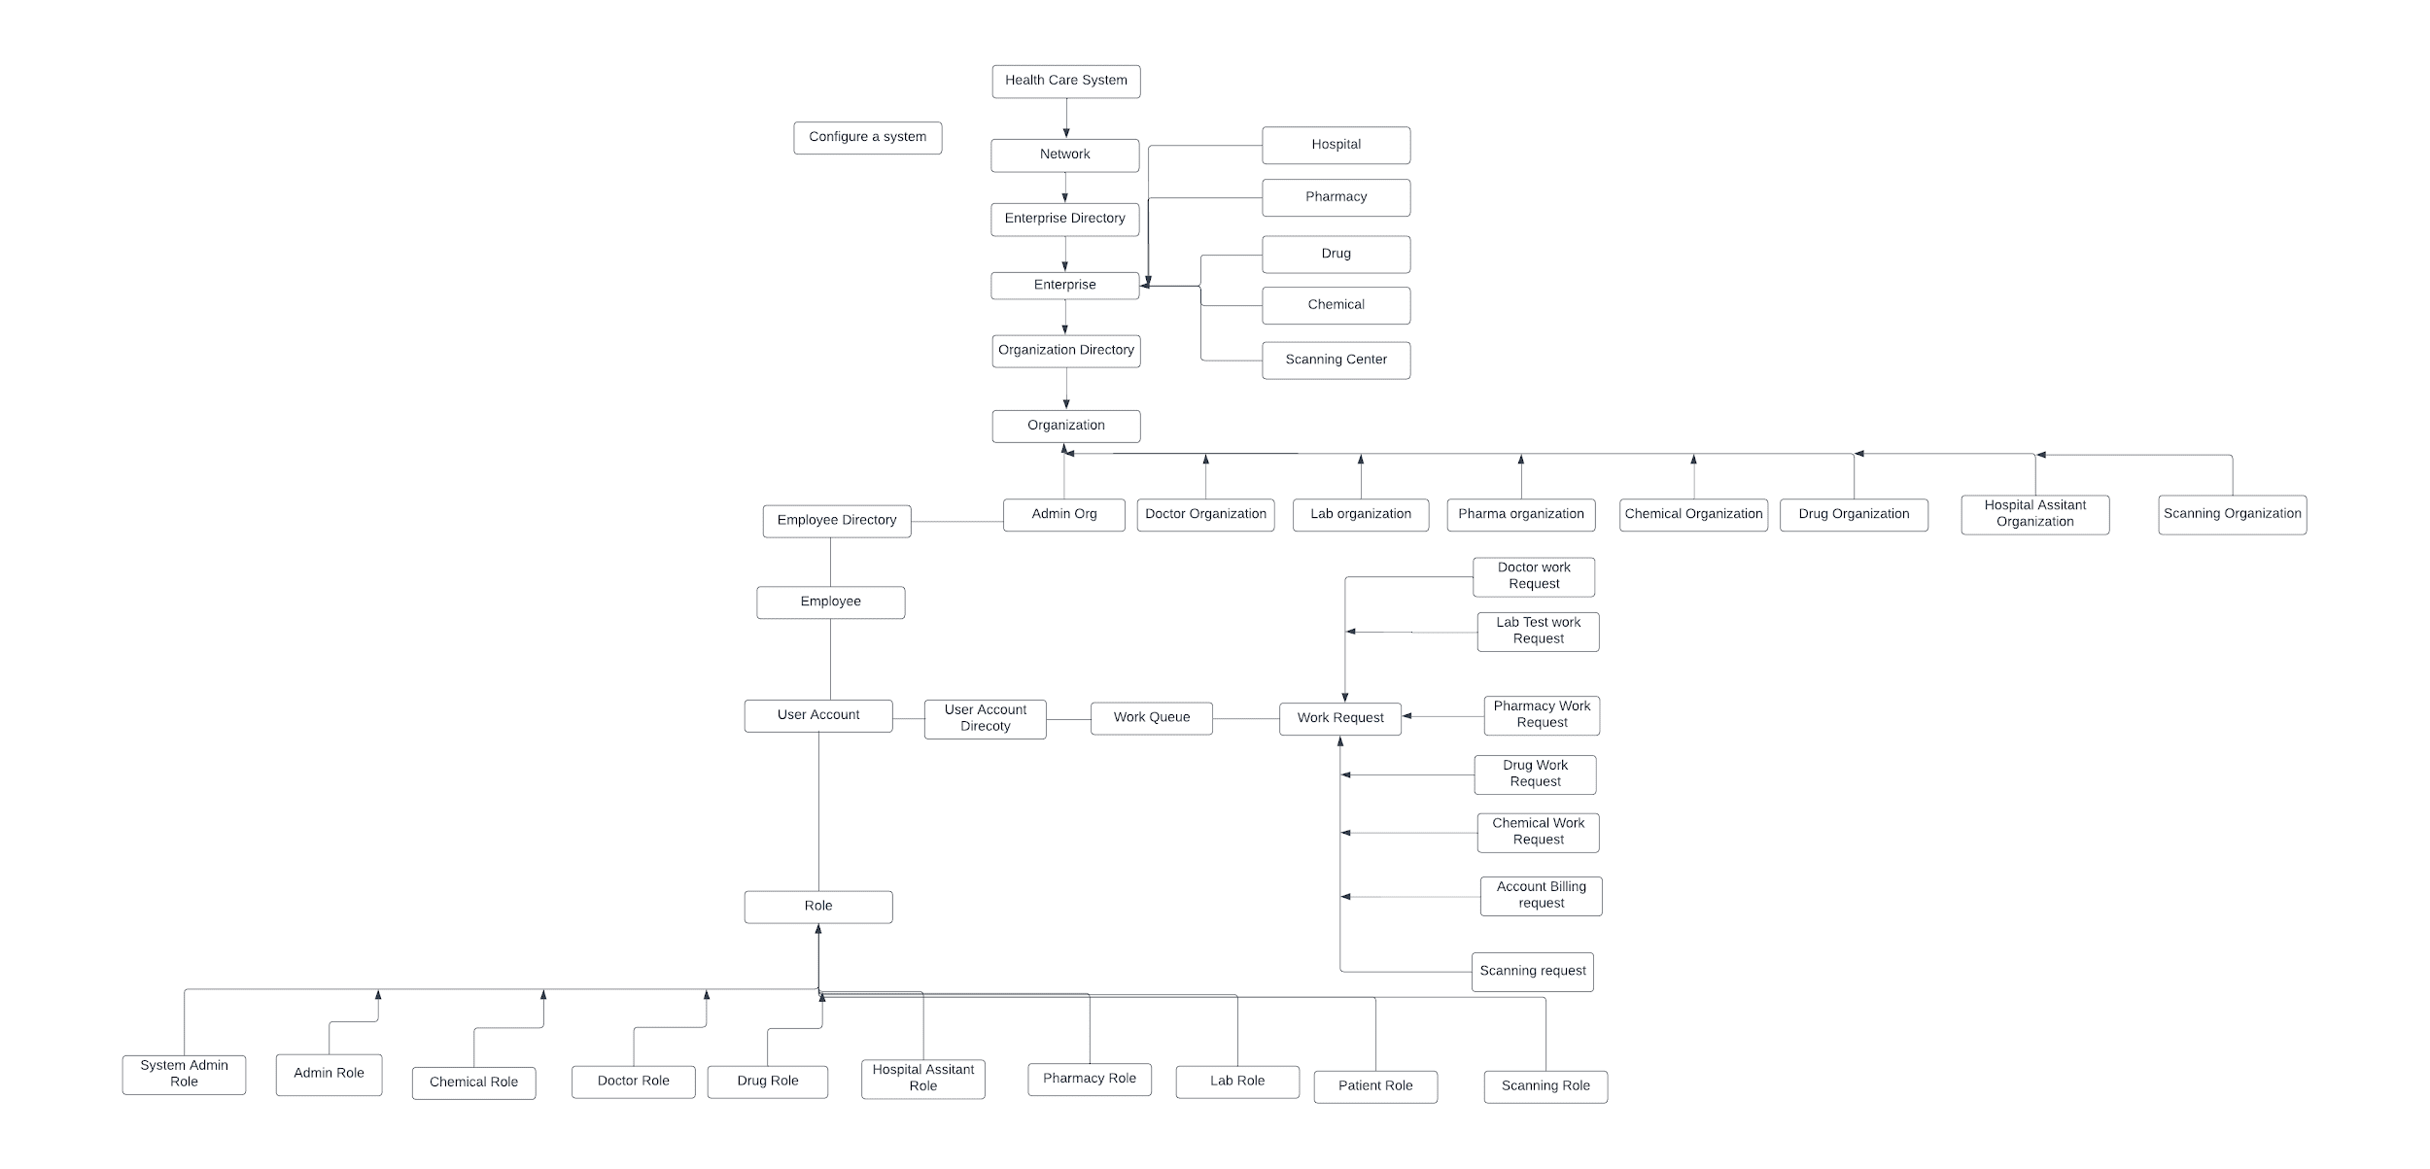
Architecture diagram

Slide 7
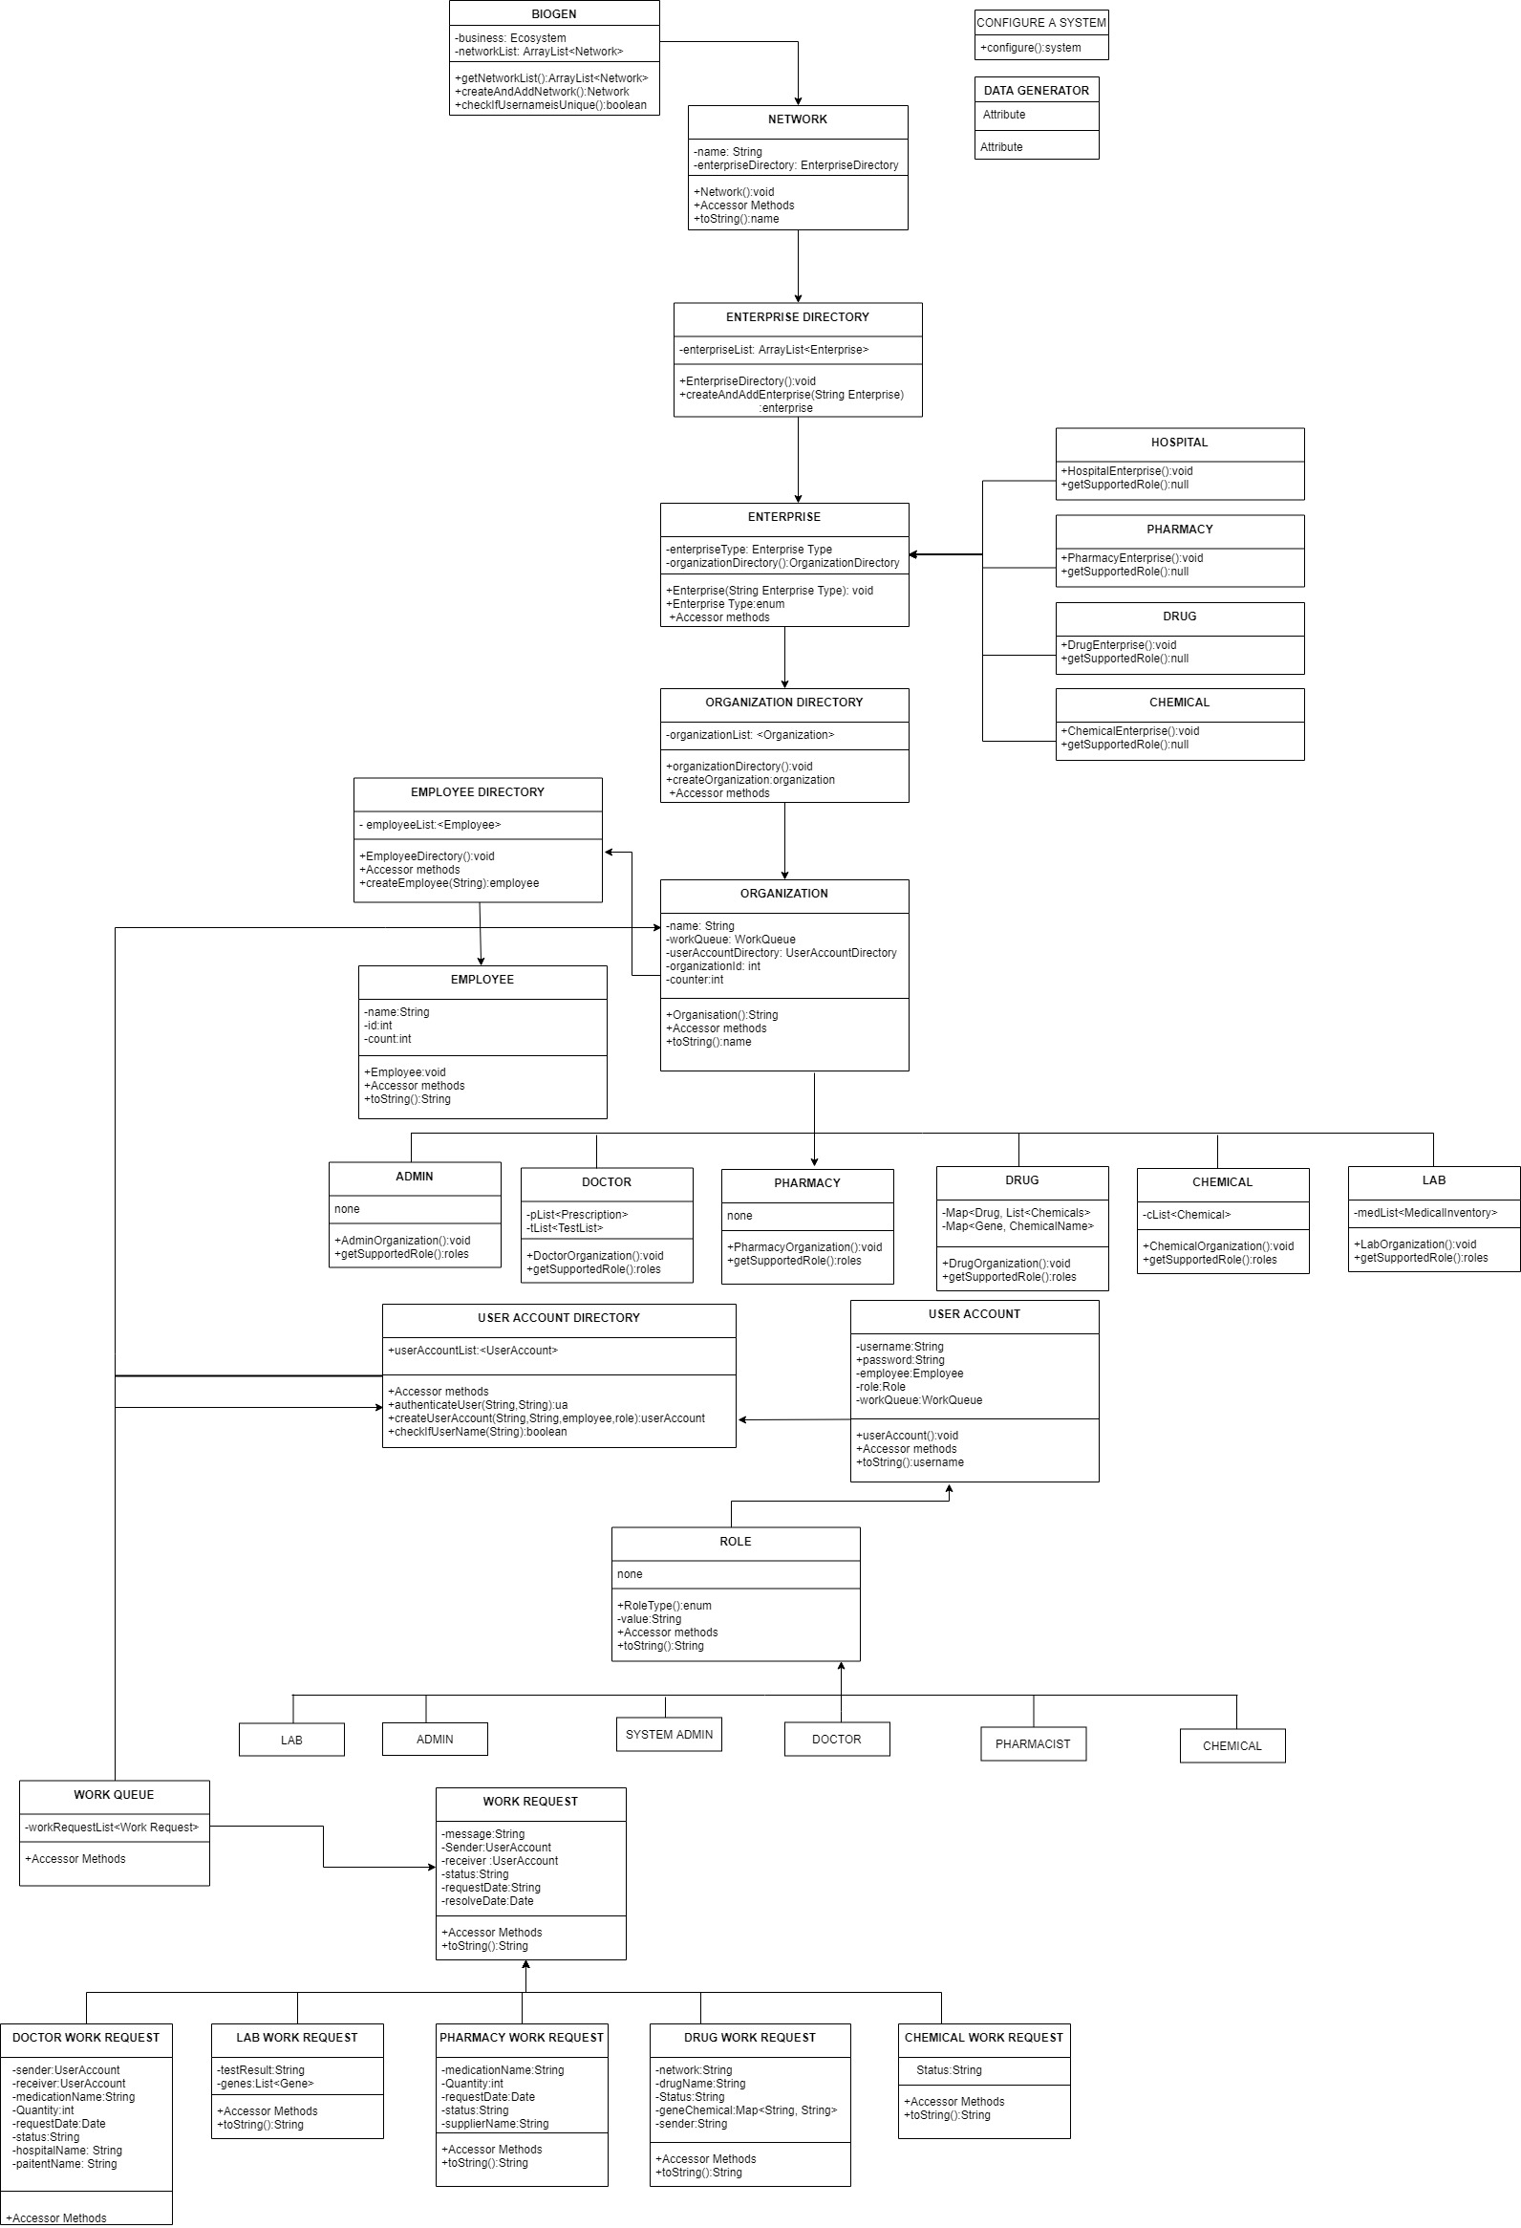
Object Model

Slide 8
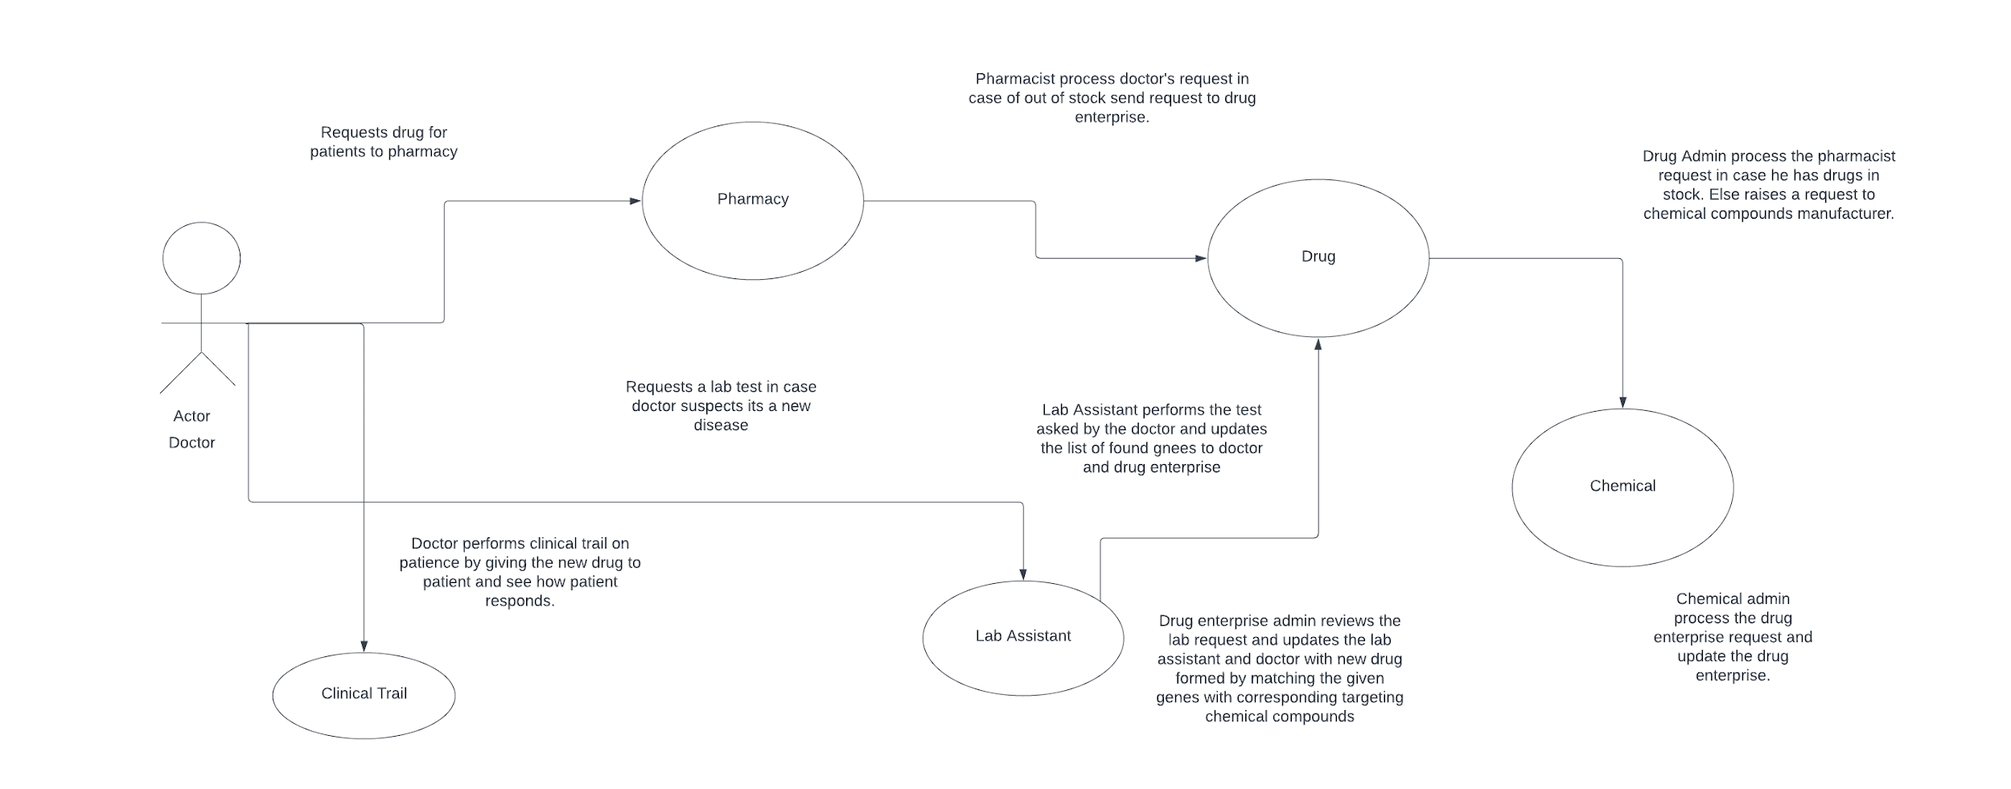
Use cases

Slide 9
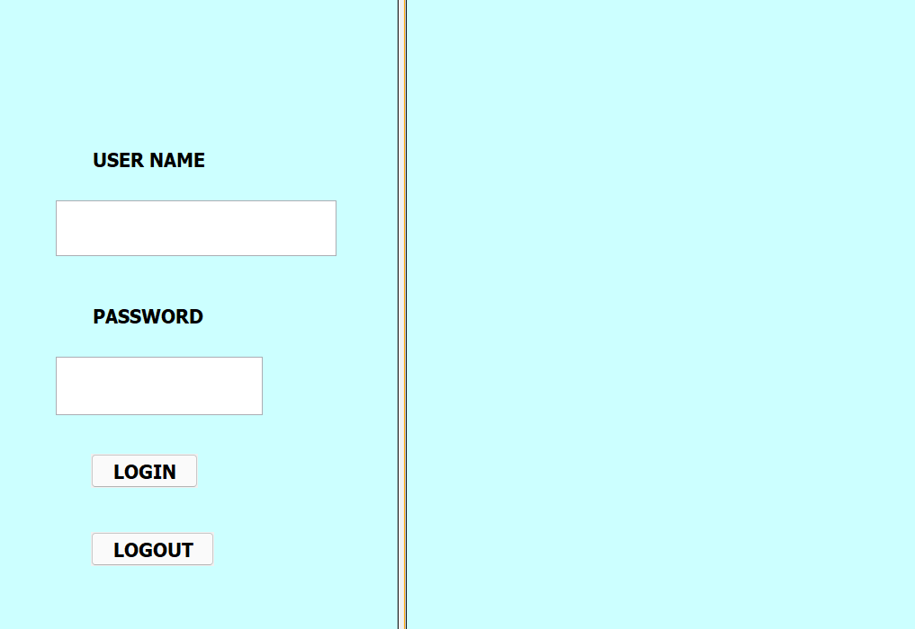

Slide 10
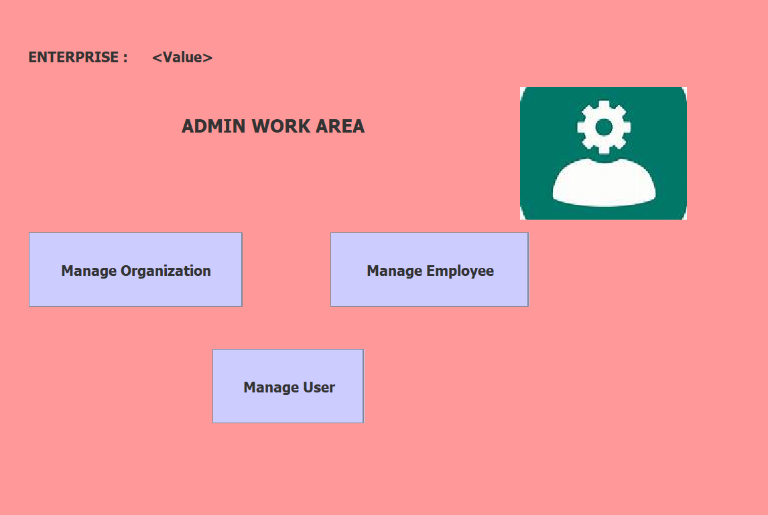

Slide 11
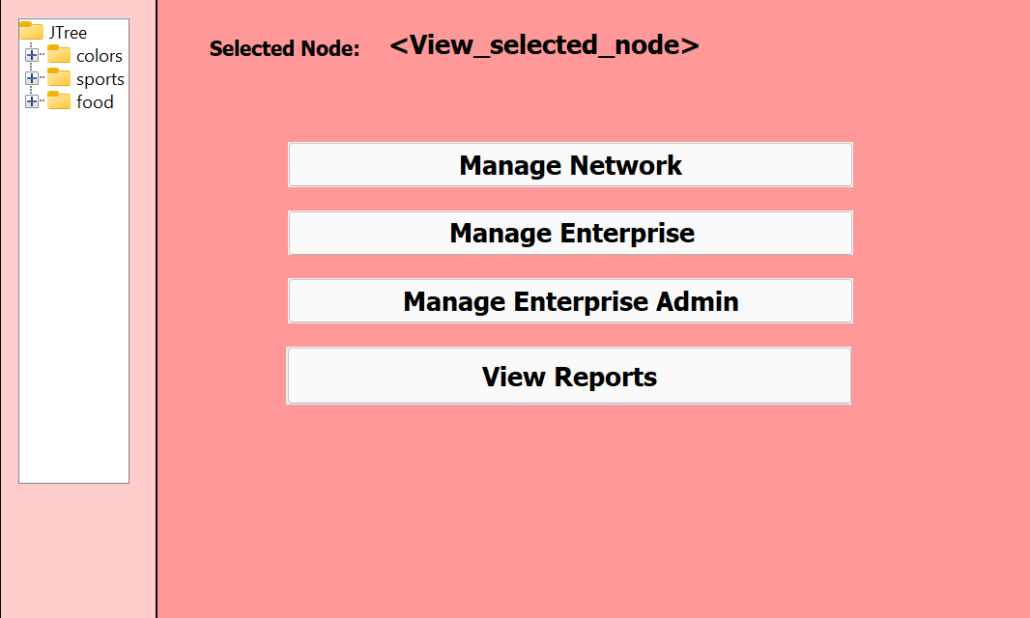

Slide 12
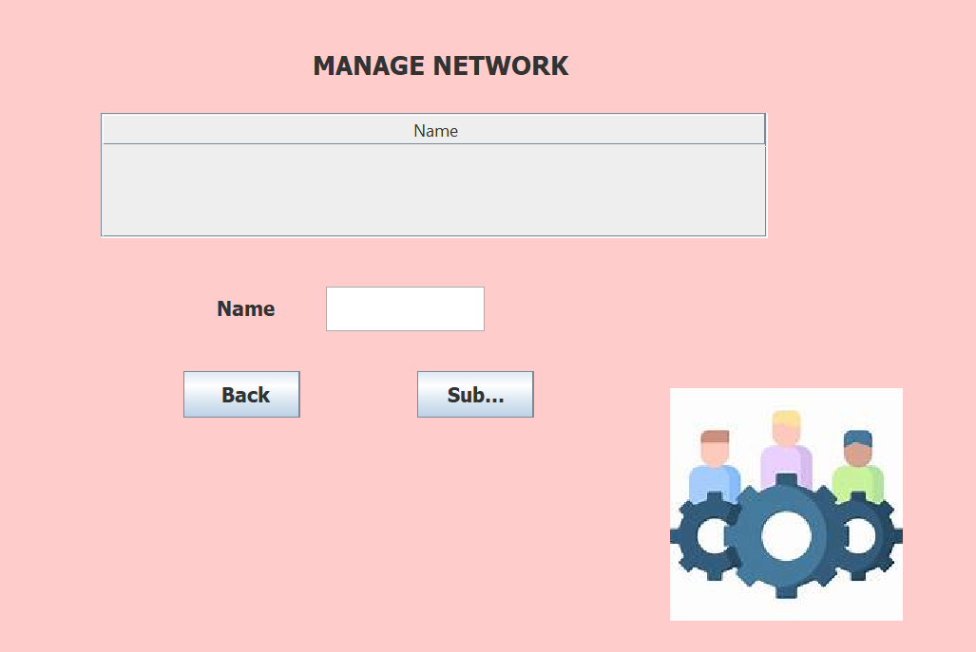

Slide 13
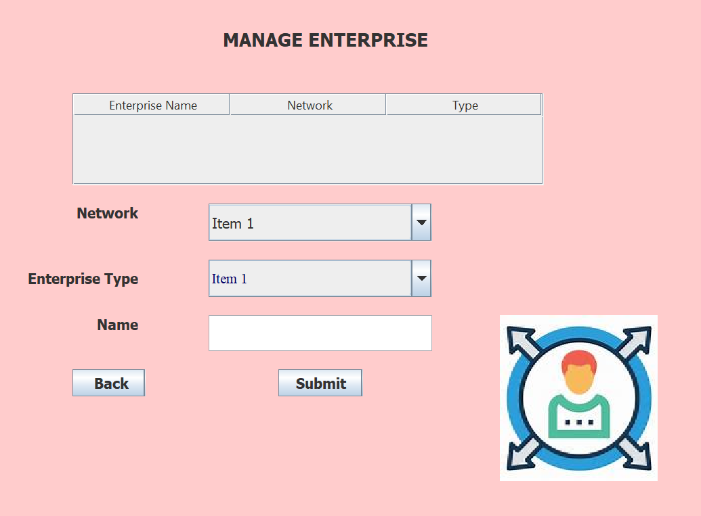

Slide 14
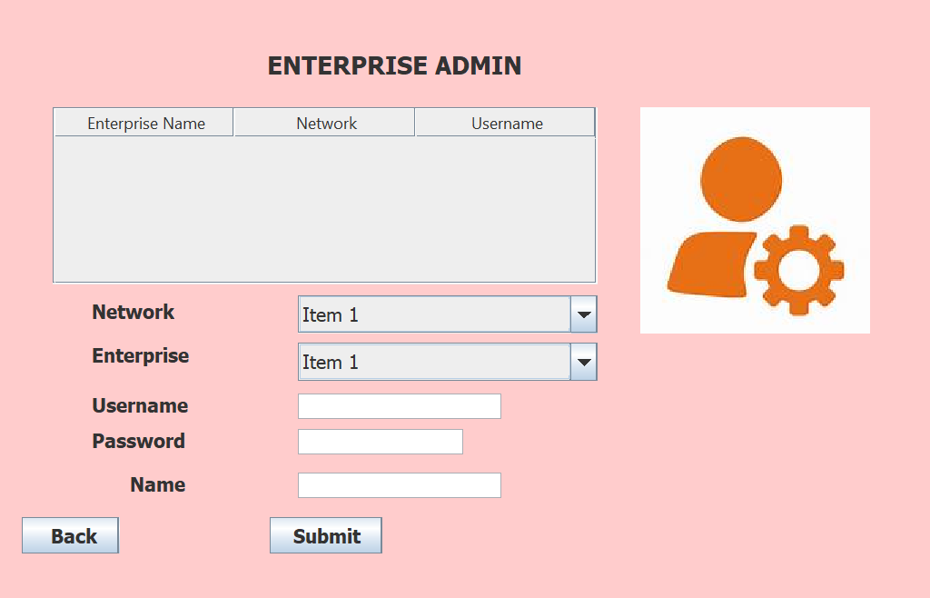

Slide 15
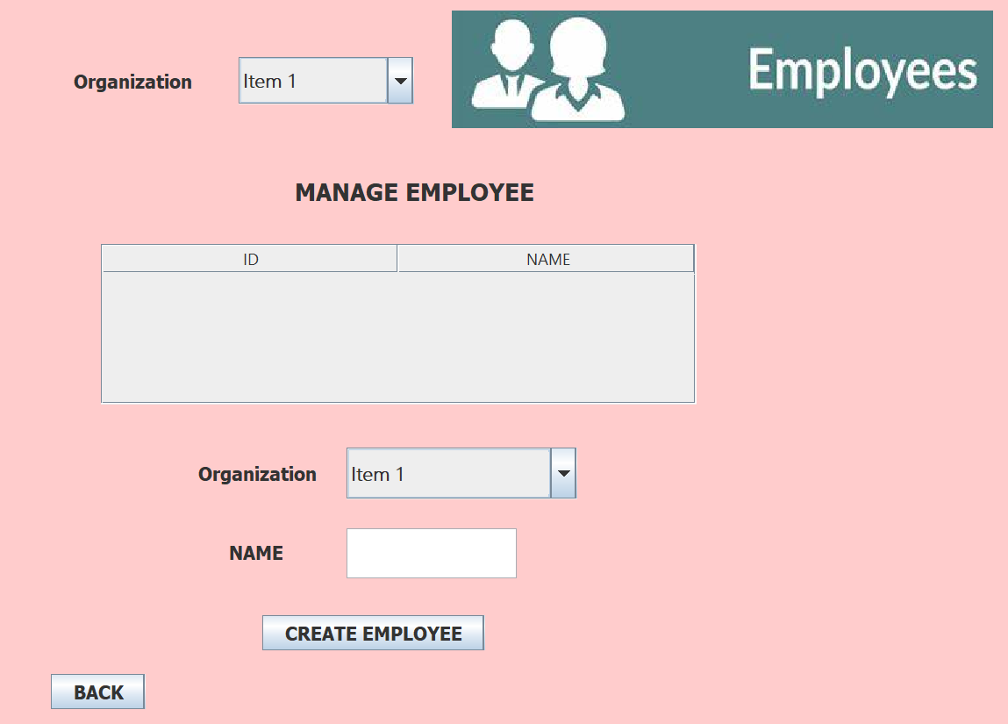

Slide 16
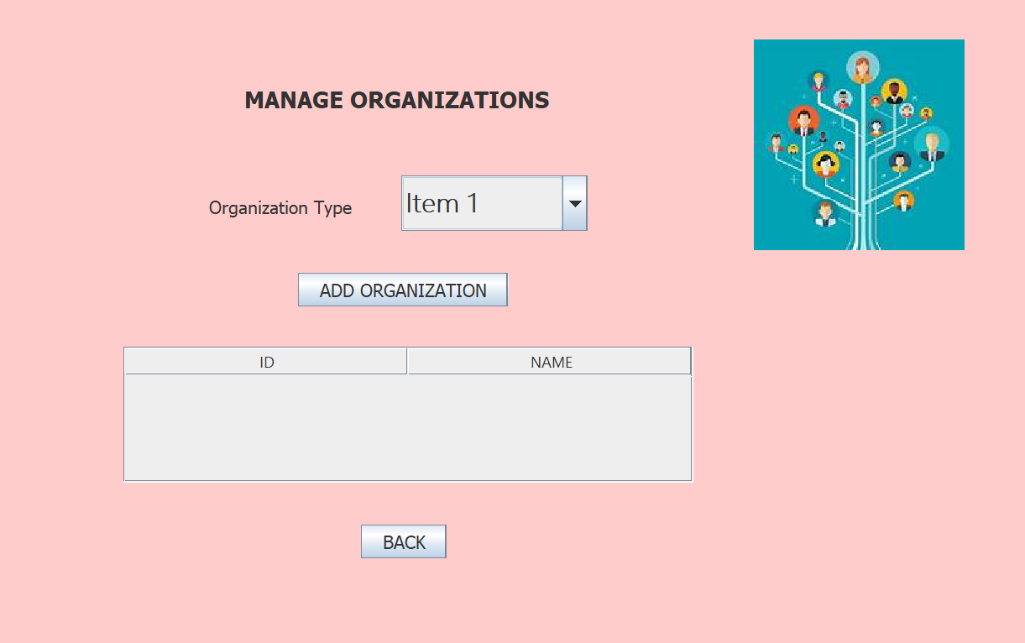

Slide 17
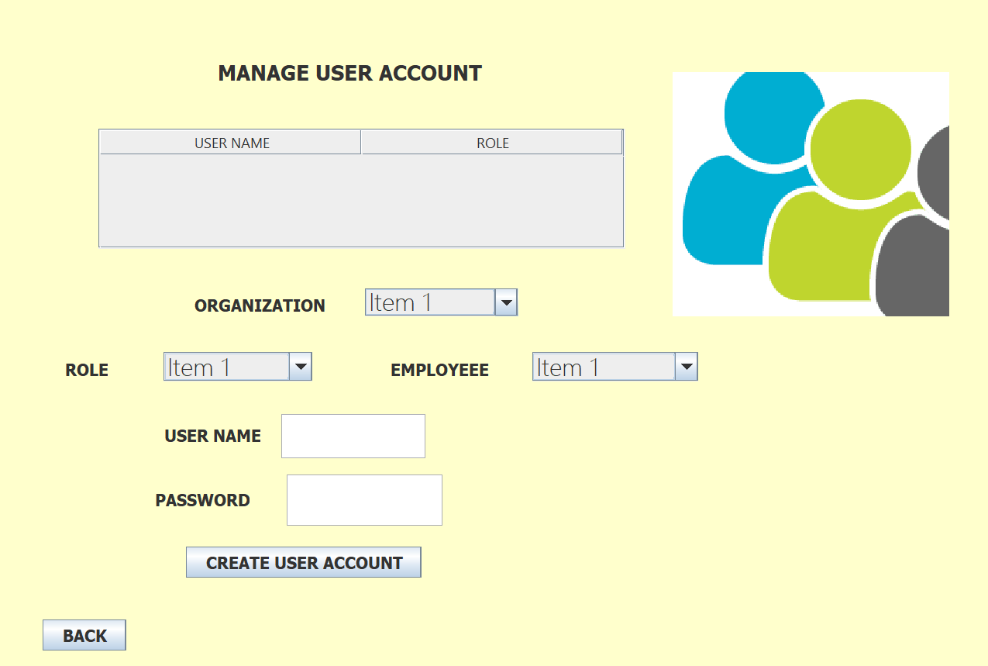

Slide 18
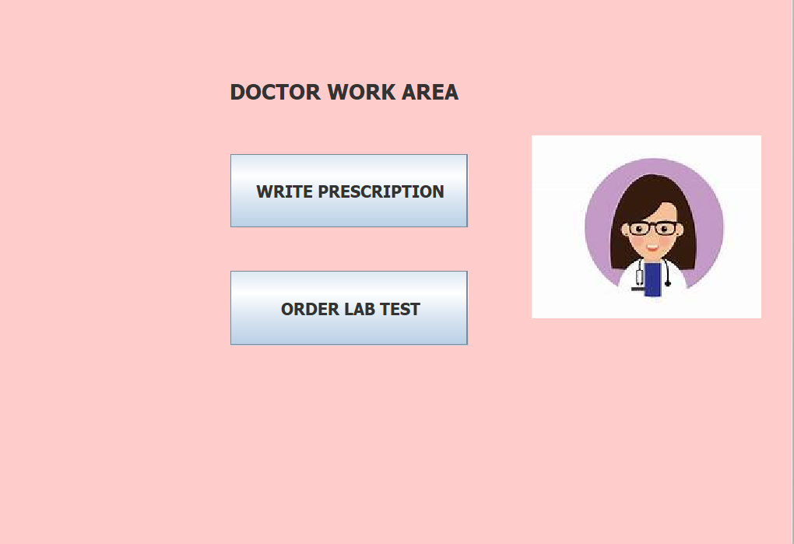

Slide 19
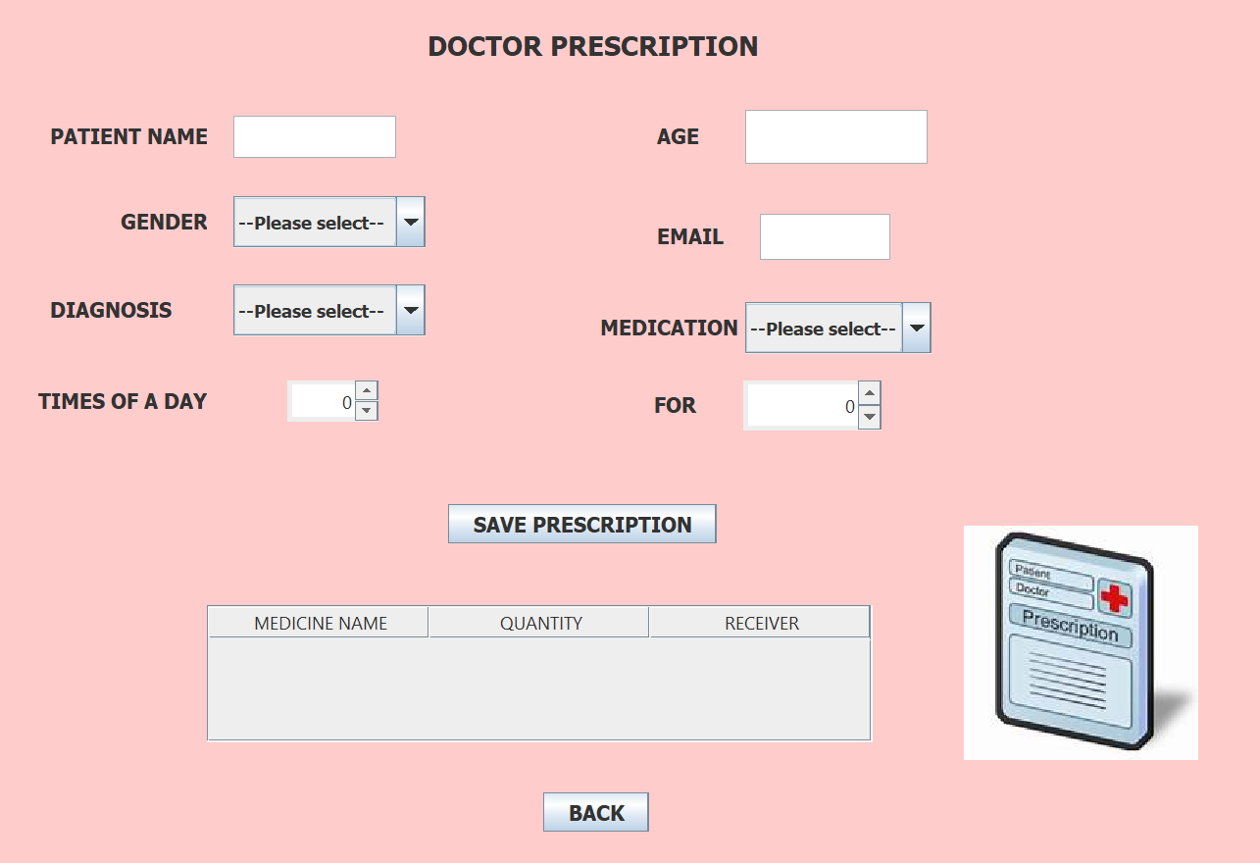

Slide 20
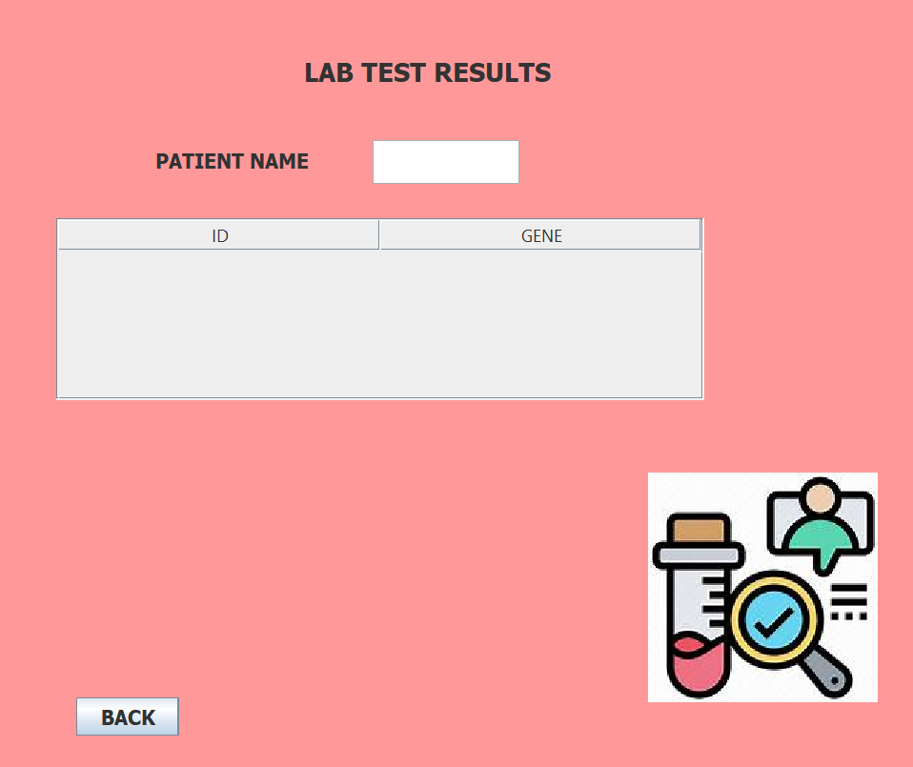

Slide 21
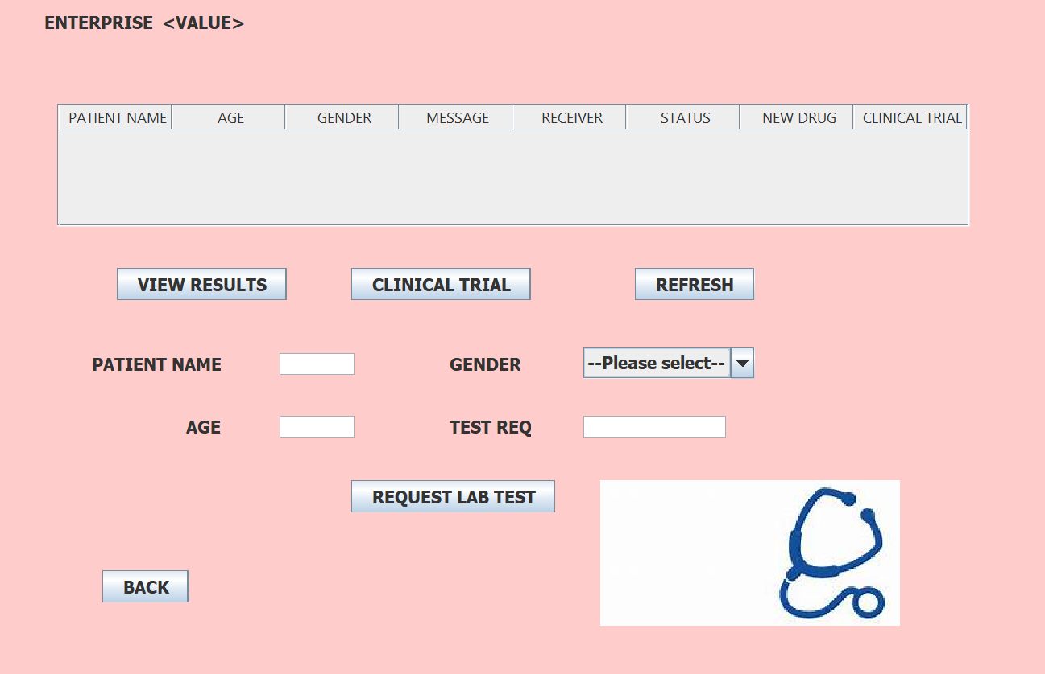

Slide 22
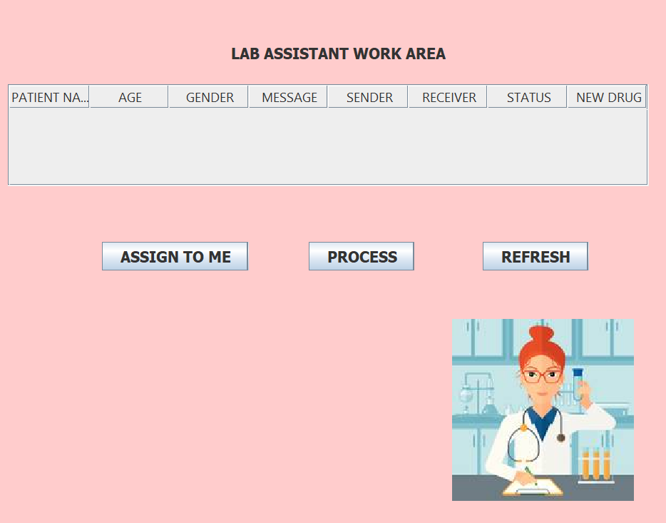

Slide 23
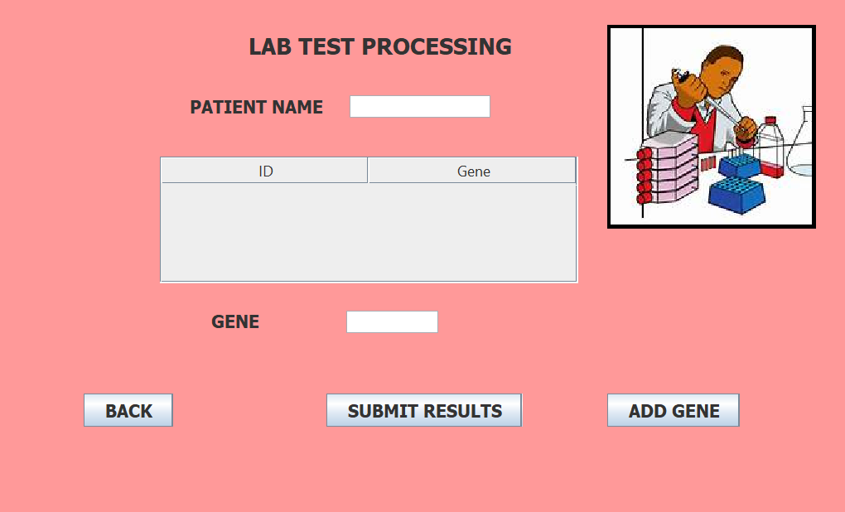

Slide 24
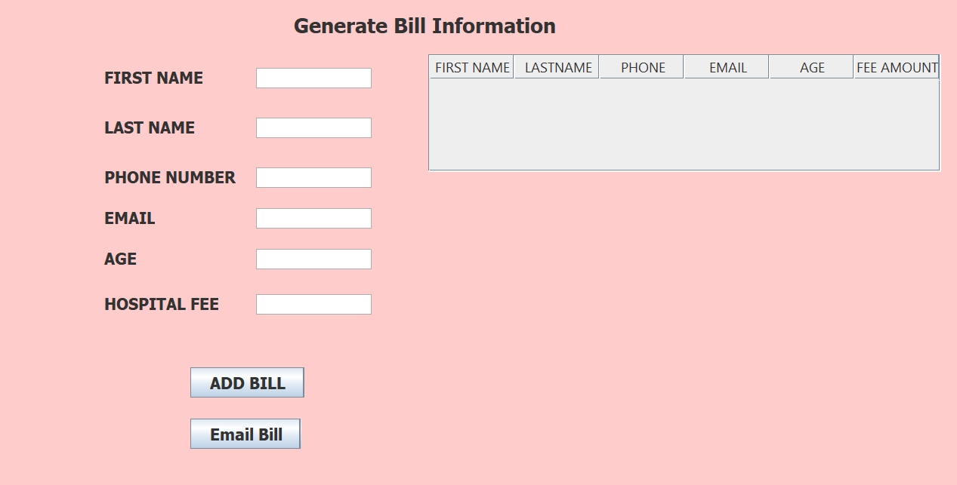

Slide 25
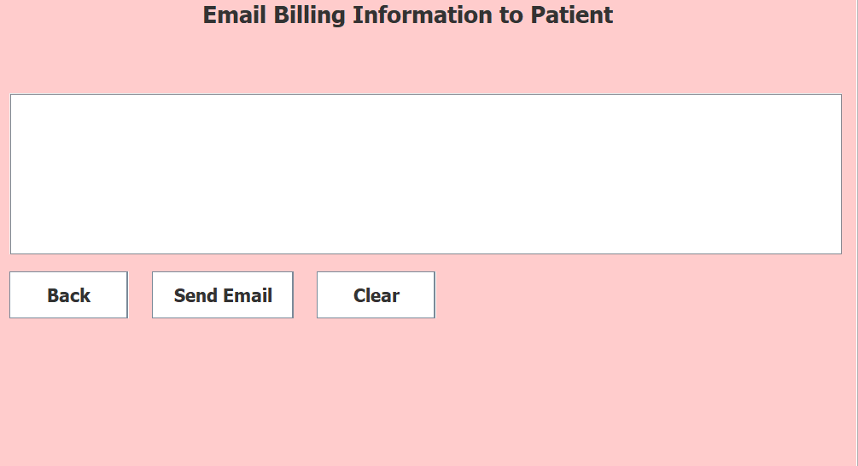

Slide 26
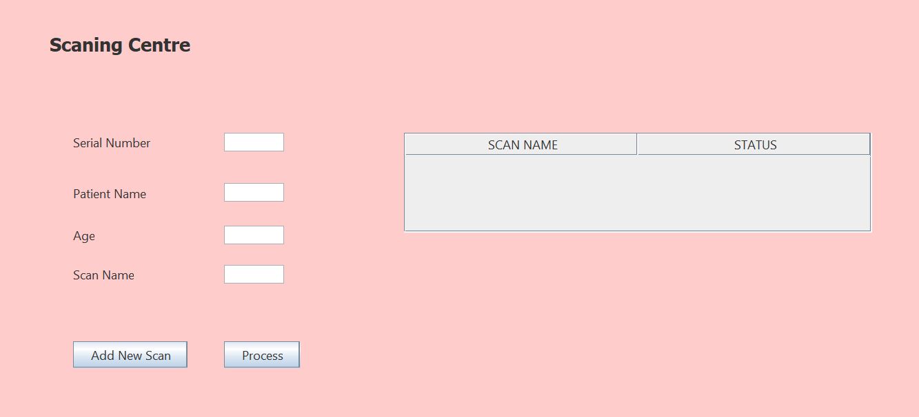

Slide 27
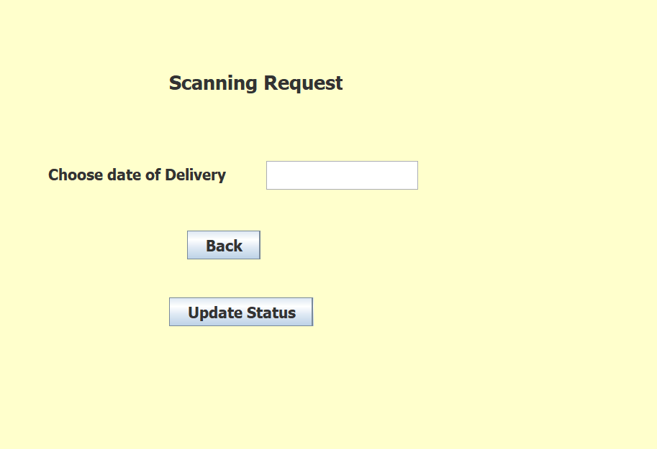

Slide 28
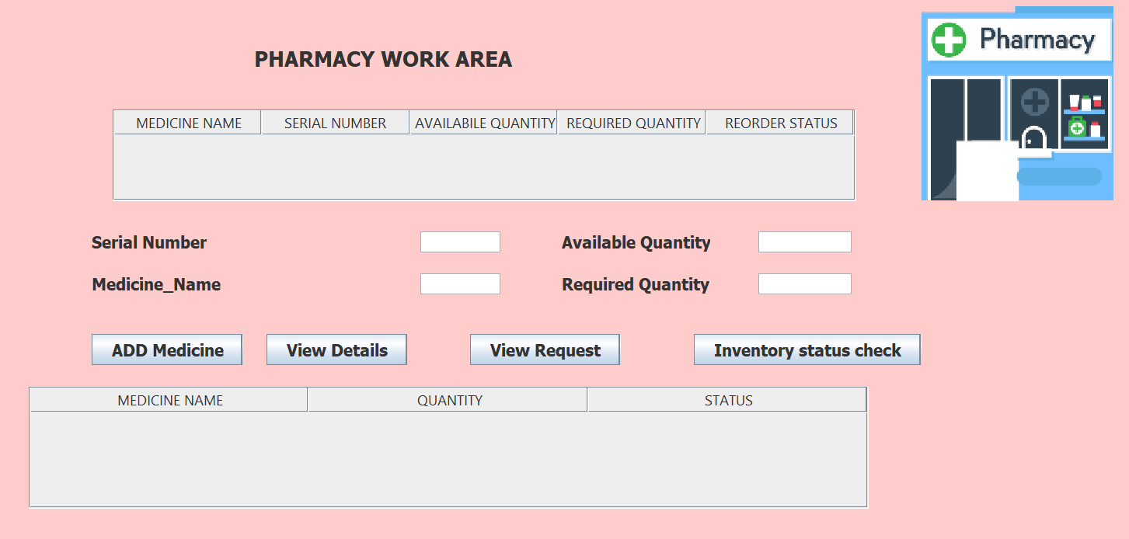

Slide 29
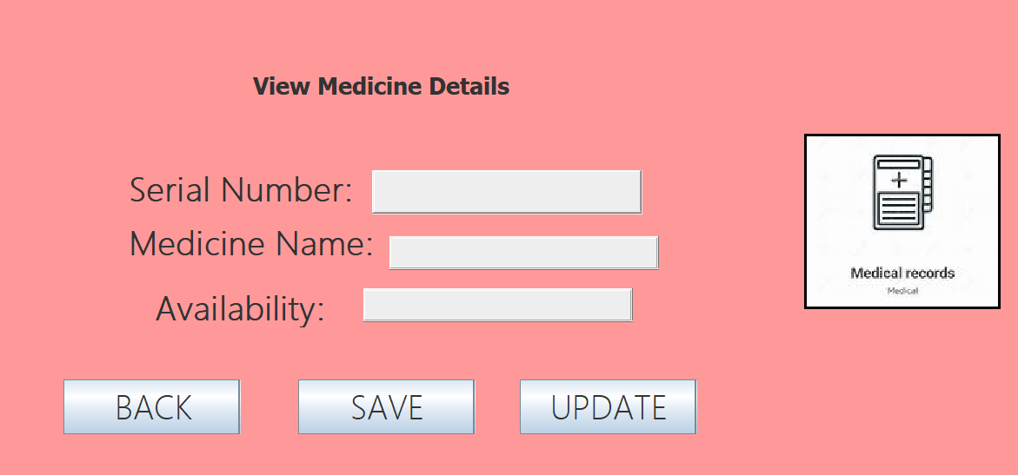

Slide 30
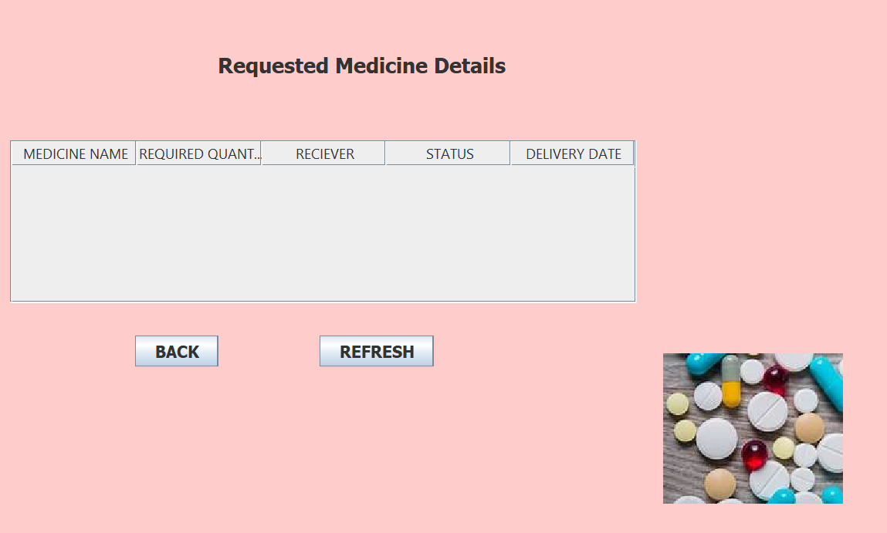

Slide 31
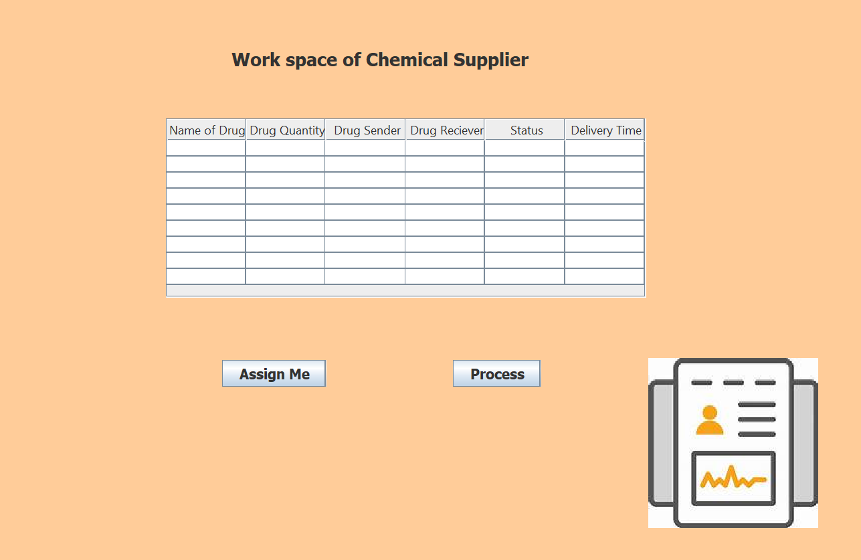

Slide 32
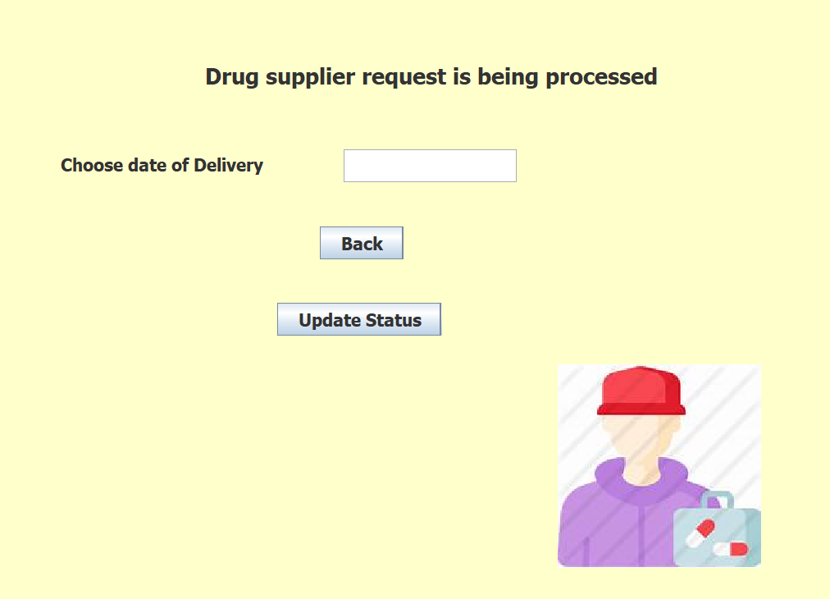

Slide 33
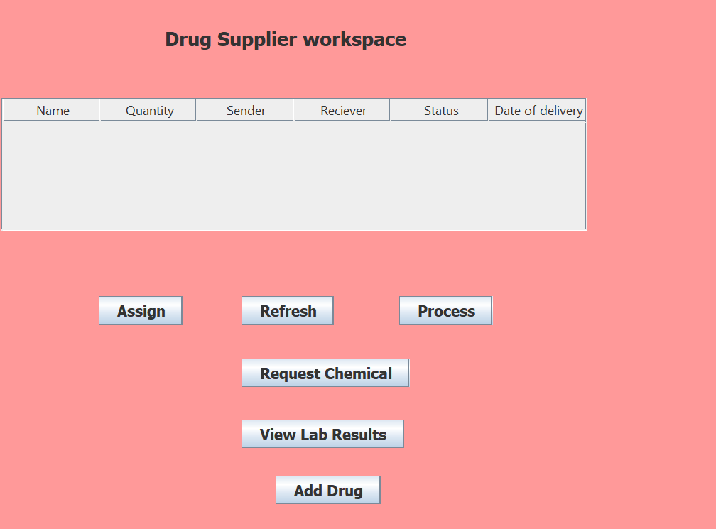

Slide 34
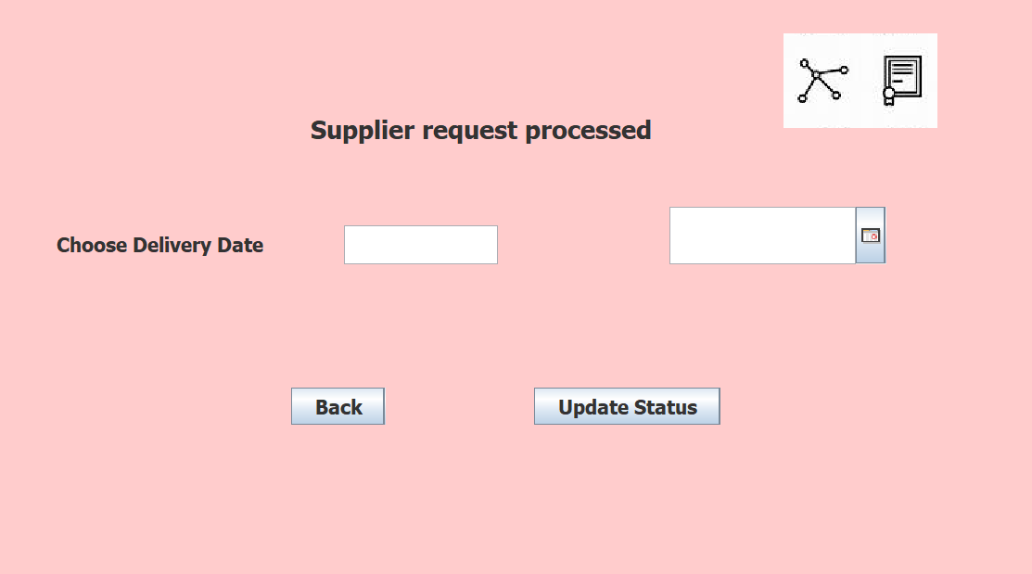

Slide 35
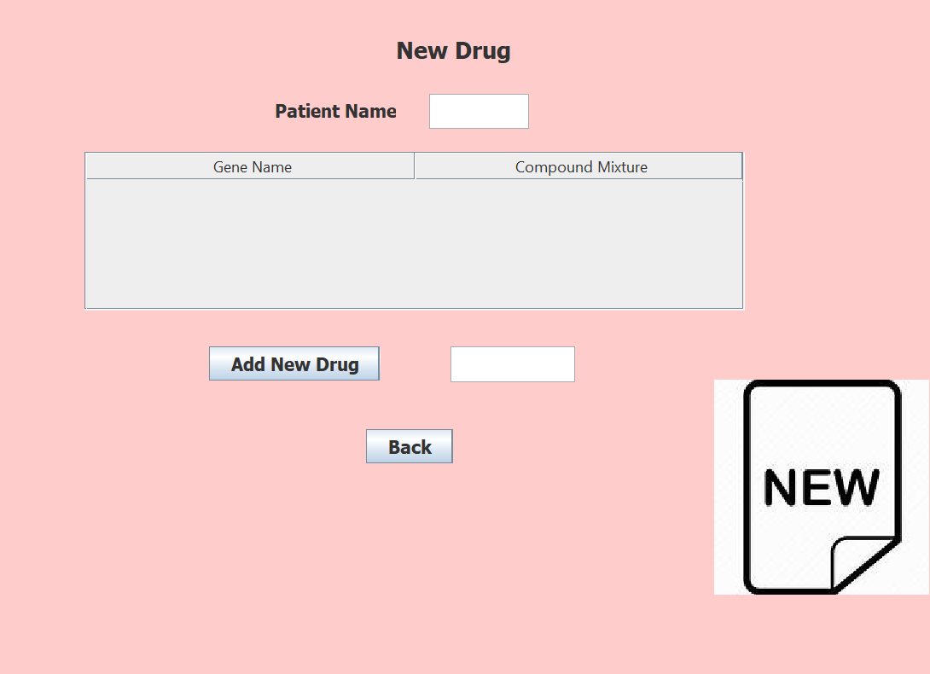

Slide 36
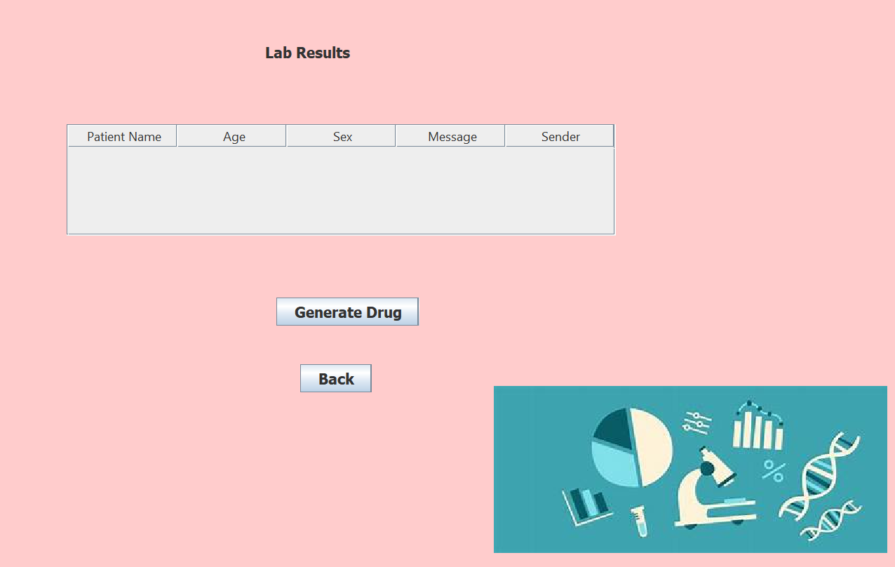

Slide 37
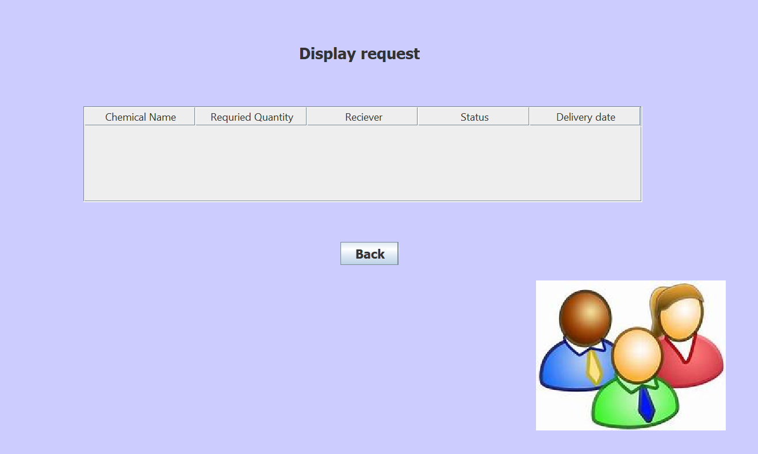

Slide 38
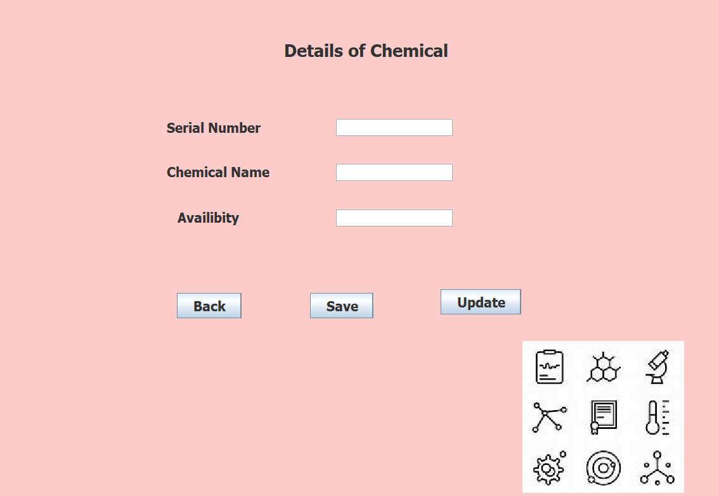

Slide 39
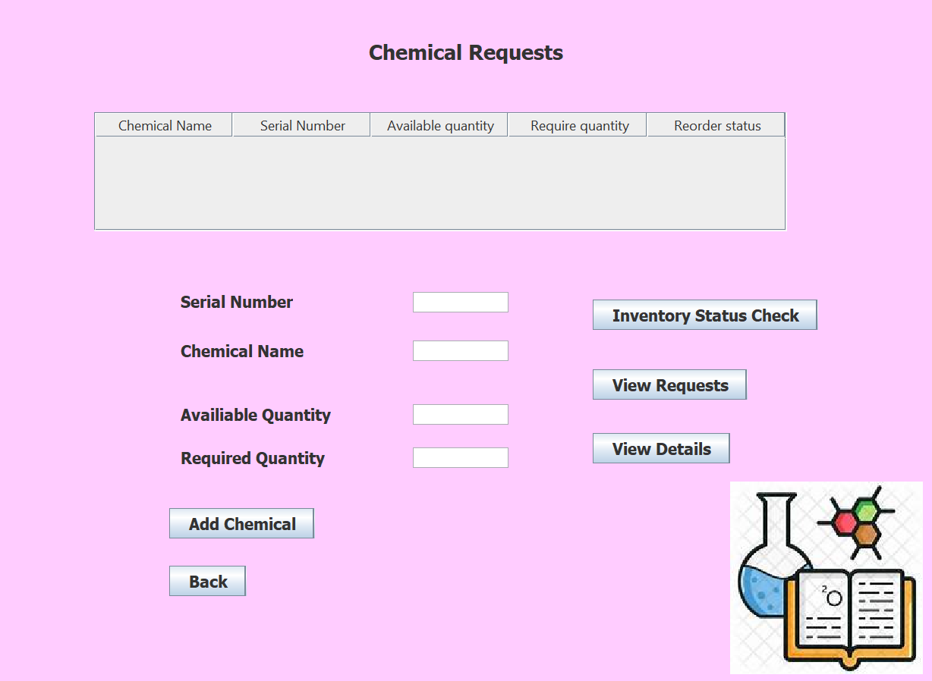

Slide 40
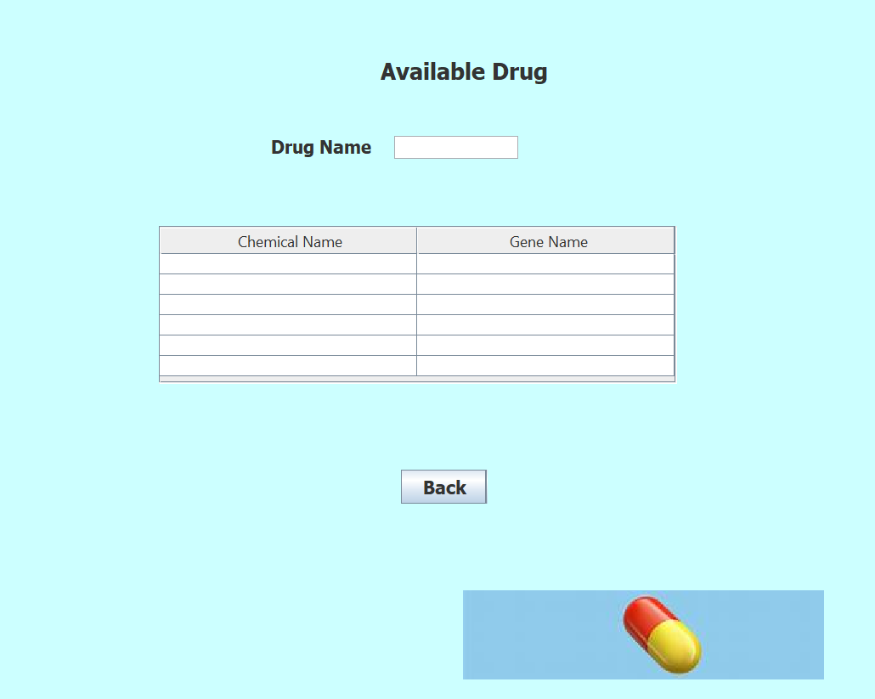

Slide 41
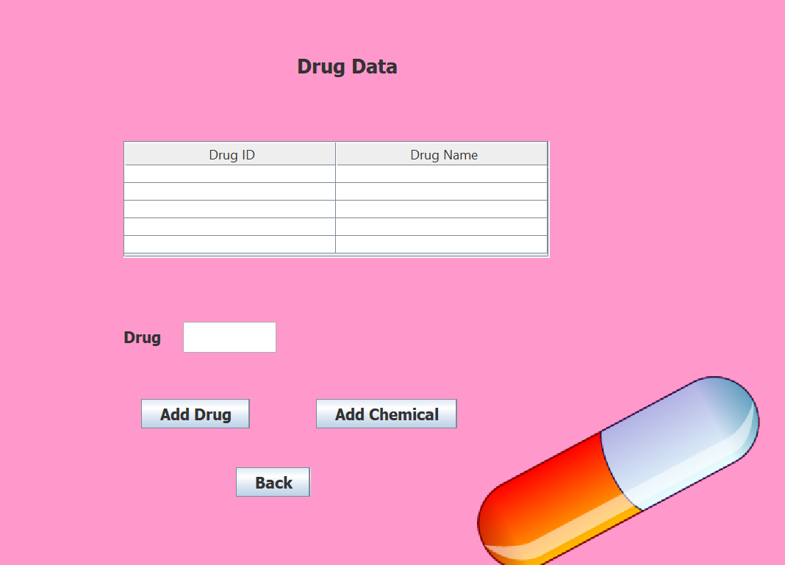

Slide 42
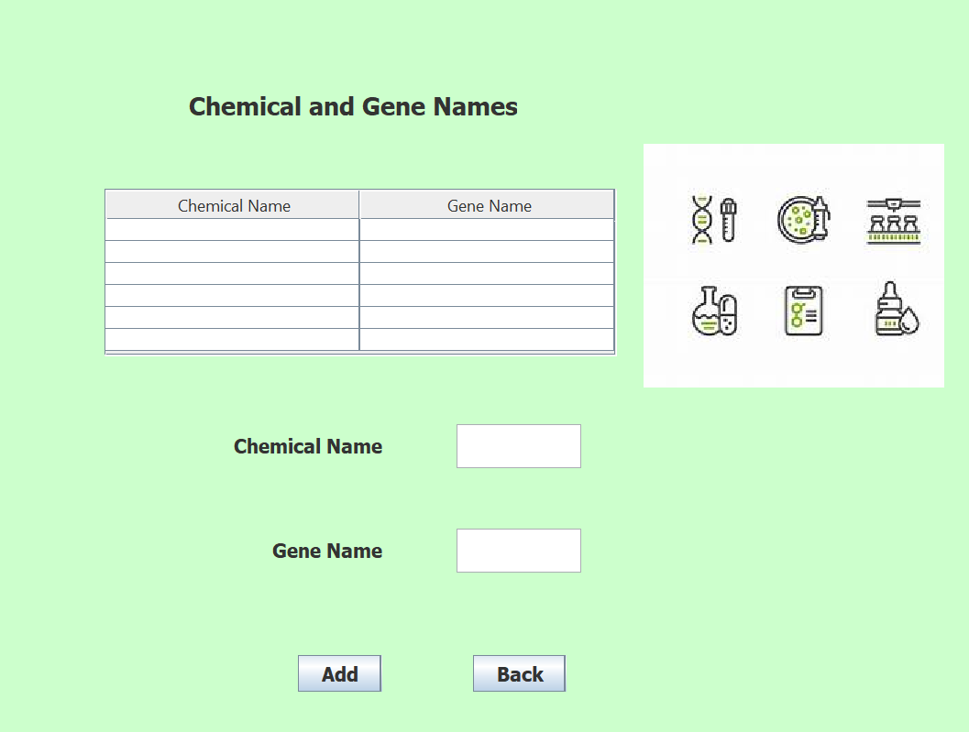

Slide 43
BENEFITS
We believe that adopting a unified global data standard and modernizing the healthcare value system would aid the Health Care Model system in advancing patient care improvements.
Moreover, millions of people around the country can receive safer and more cost-effective healthcare.
Keeping track of inventories throughout many organizations makes it possible and provide medicines to patients more quickly.

Slide 44

Thank you
THANK YOU………..

